Slide 1
History
From an Anabaptists perspective

Slide 2
Introduction
Who I am.
Who I’m not.
Quote
☺

Slide 3
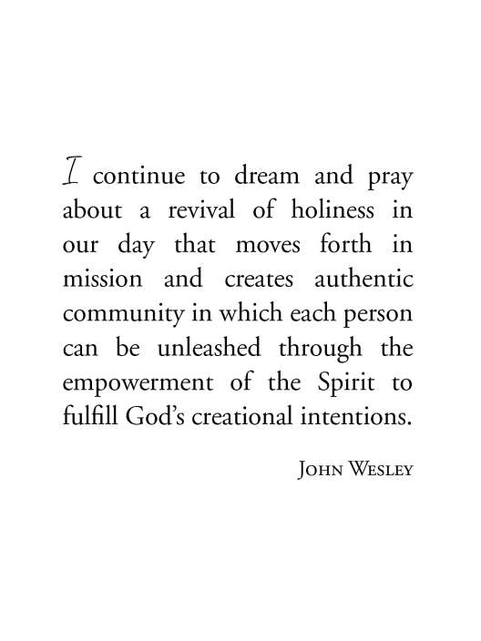
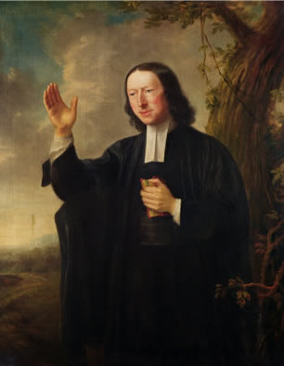

Slide 4
My point:
To truly experience the presence of the indwelling Christ and to be transformed into His likeness.
To be able to read the Bible and understand history through the lenses of Jesus Christ.
To see the central message of the Kingdom of God throughout the Bible and history.
To see that Jesus came to establish His kingdom on earth—NOW.
To appreciate that your local church community is the representation of that kingdom to the world.
To dream and to act like you believe it!

Slide 5
His
story

Slide 6
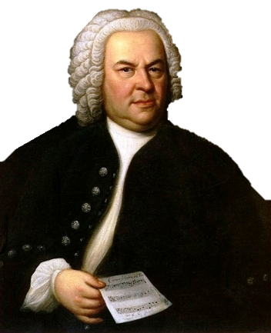
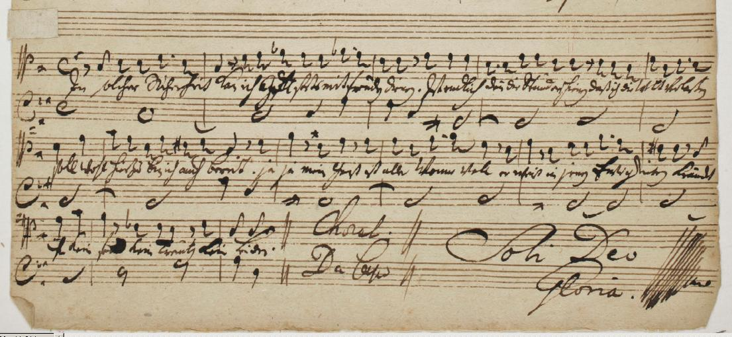
Bach…Symphony or Stuffing?

Slide 7
Right answers to the wrong questions?
When you read something the wrong way we end up with the wrong questions.
The problem is that with a little work we actually get the right answers to the wrong questions.
Example: which manuscript makes better cushion for the trees, the leather cover etc.

Slide 8
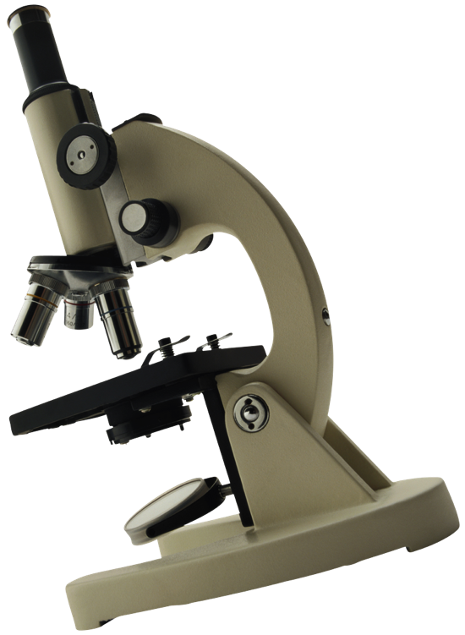
Purpose?
What is the central message of the Bible?
“Then the channels of waters were seen, and the foundations of the world were discovered at thy rebuke, O LORD, at the blast of the breath of thy nostrils.” (Psa 18:15 )

Slide 9
The Christ Centered Bible
The Story of Jesus

Slide 10
The Kingdom of God
Mat 25:34 Then shall the King say unto them on his right hand, Come, ye blessed of my Father,
inherit the kingdom
prepared for you from the foundation of the world.
Act 28:23 And when they had appointed him a day,
there came many to him into his lodging; to whom he
expounded and testified the kingdom of God,
persuading them concerning Jesus, both out of the law
of Moses, and out of the prophets, from morning till
evening.

Slide 11
Priority?
“But seek ye first the kingdom of God.” (Matt 6:33)
Pray…”Thy kingdom come” (Matt 6:10)
“For I determined not to know any thing among you, save Jesus Christ, and him crucified.” (1Co 2:2)

Slide 12
In the Beginning…
God

Slide 13
The Word
Joh 1:1 In the beginning was the Word, and the Word was with God, and the Word was God. The same was in the beginning with God. All things were made by him; and without him was not any thing made that was made. In him was life; and the life was the light of men. And the light shineth in darkness; and the darkness comprehended it not

Slide 14
God is here!
Jer 9:23 Thus saith the LORD, Let not the wise man glory in his wisdom, neither let the mighty man glory in his might, let not the rich man glory in his riches: But let him that glorieth glory in this
, that he understandeth
and knoweth me,
that I am the LORD which exercise
lovingkindness, judgment, and righteousness, in the earth: for in these things I delight, saith the LORD.

Slide 15
And God Said….
“In the beginning God made something out of absolutely
Nothing… that principal has never changed.” (pastor Elu)
God’s pronouncements are not suggestions—they are creation. Nor are they like the Greek philosophers that claimed the gods produces an alternate reality. When He speaks…. he creates.
God’s pronouncement of salvation is not one of recognition or mirage, it is rather creation.

Slide 16
Two Trees
Gen 2:9 And out of the ground made the LORD God to grow every tree that is pleasant to the sight, and good for food; the tree of life also in the midst of the garden, and the tree of knowledge of good and evil.
Two Ways…Didache
Two Ways…Shleitheim Confession
Two Kingdoms

Slide 17
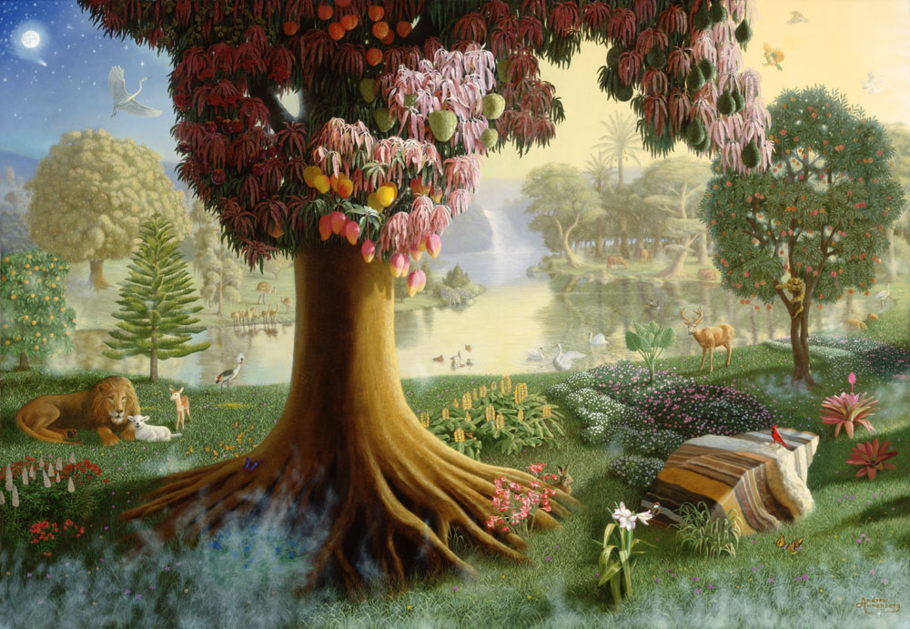

Slide 18
Tree of life
Living by the “infilling” power of God.
Rev 22:14 Blessed are they that do his commandments, that they may have right to the tree of life, and may enter in through the gates into the city.
Rev 2:7 He that hath an ear, let him hear what the Spirit saith unto the churches; To him that overcometh will I give to eat of the tree of life, which is in the midst of the paradise of God.

Slide 19
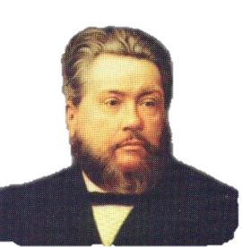
Jesus is Life
“We believe our Lord Jesus Christ to be none
other than that Tree of Life whose leaves are
for the healing of the nation.”
(Spurgeon –Christ the tree of Life)

Slide 20
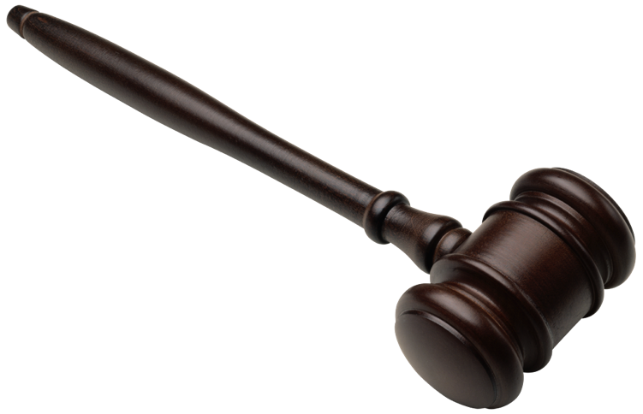
Do good Stuff.
Don’t do bad stuff.
Law

Slide 21
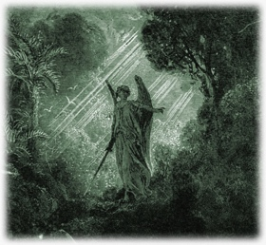
These two can not mix!
Gen 3:22 And the LORD God said, Behold, the man is become as one of us, to know good and evil: and now, lest he put forth his hand, and take also of the tree of life, and eat, and live for ever:
Gen 3:23 Therefore the LORD God sent him forth from the garden of Eden, to till the ground from whence he was taken.
Picture of f;ame
image

Slide 22
“And he said, Who told thee that thou wast naked? Hast thou eaten of the tree, whereof I commanded thee that thou shouldest not eat?” (Gen 3:11 )
First mistake?
To talk about God like he isn't there.
Who?

Slide 23
Law and Fear
Gen 4:15 And the LORD said unto him,
Therefore whosoever slayeth Cain,
vengeance shall be taken on him sevenfold.
And the LORD set a mark upon
Cain, lest any finding him should kill him.

Slide 24
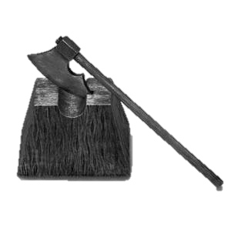
Fear of punishment
Gen 4:23 And Lamech said unto his wives, Adah and Zillah, Hear my voice; ye wives of Lamech, hearken unto my speech: for I have slain a man to my wounding, and a young man to my hurt.
Gen 4:24 If Cain shall be avenged sevenfold, truly Lamech seventy and sevenfold.

Slide 25
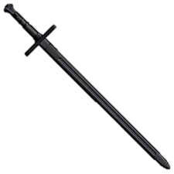
Peter Riedemann
(Before the flood) “God no longer wanted His spirit to strive with those who were carnally minded, and yet He did not want the earth to be completely bloodstained or the evildoers to remain unpunished. Therefore, he had to have an instrument of punishment. That as it was said above was the ruling power to which He gave the command that whosoever sheds human blood, shall also have his blood shed. Form this we see that power and government have grown from God’s wrath and punishment, rather than from His blessing. “
“…Since people did not want to let themselves to be led by the spirit of the Lord, God had to use a different rod to protect them from harm. This was done so that the land would not be completely polluted with bloodguilty people, and so that He would not have to destroy the whole world on their account. The world could thus be preserved until the time of the promised offspring, in whom all things would be made right.” Pg. 215-222

Slide 26
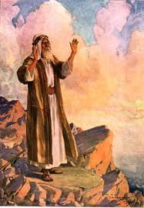
The Remnant
“…and he called his name Enos: then began men to call upon the name of the LORD.” (Gen 4:26 )
Picture of praying

Slide 27
Two Ways
Gen 6:5 And GOD saw that the wickedness of man was great in the earth, and that every imagination of the thoughts of his heart was only evil continually.
Gen 6:8-9 But Noah found grace in the eyes of the LORD. These are the generations of Noah: Noah was a just man and perfect in his generations, and Noah walked with God.

Slide 28
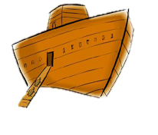
Kingdom-- in a boat
But with thee will I establish my covenant; and thou shalt come into the ark, thou, and thy sons, and thy wife, and thy sons' wives with thee. (Gen 6:18 )

Slide 29
Law after Noah
“ …for man's sake; for the imagination
of man's heart is evil from his
youth; (Gen 8:21)
“Whoso sheddeth man's blood, by man shall his blood be shed: for in the image of God made he man.” (Gen 9:6 )

Slide 30
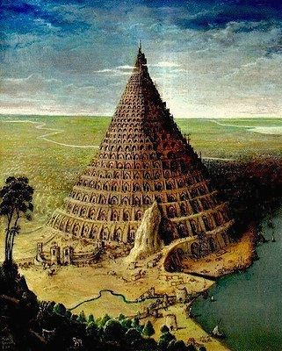

Slide 31
“Let us makes us a name.”
Gen 11:4 And they said, Go to, let us build us a city and a tower, whose top may reach unto heaven; and let us make us a name, lest we be scattered abroad upon the face of the whole earth.
I am the LORD: that is my name: and my glory will I not give to another” (Isa 42:8)

Slide 32
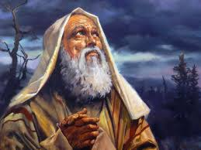
Abraham
And I will make of thee a great nation, and I will bless thee, and make thy name great; and thou shalt be a blessing: And I will bless them that bless thee, and curse him that curseth thee: and in thee shall all families of the earth be blessed. (Gen 12:2 )

Slide 33
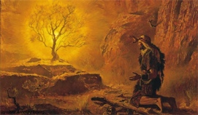
Moses
“Ye have seen what I did unto the Egyptians, and how I bare you on eagles' wings, and brought you unto myself. Now therefore, if ye will obey my voice indeed, and keep my covenant, then ye shall be a peculiar treasure unto me above all people: for all the earth is mine: And ye shall be unto me a kingdom of priests, and an holy nation. These are the words which thou shalt speak unto the children of Israel.” (Ex 19:4-6)

Slide 34
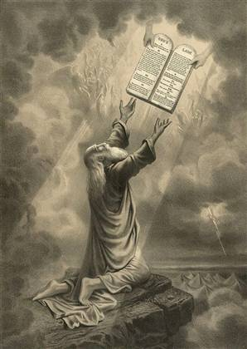
Holy Nation
Justice
Worship
Jubilee
The presence of God would be with them!
“And there I will meet with thee, and I will commune with thee from above the mercy seat, unto the children of Israel.” (Exo 25:22 )

Slide 35
Judges 9:8

Slide 36
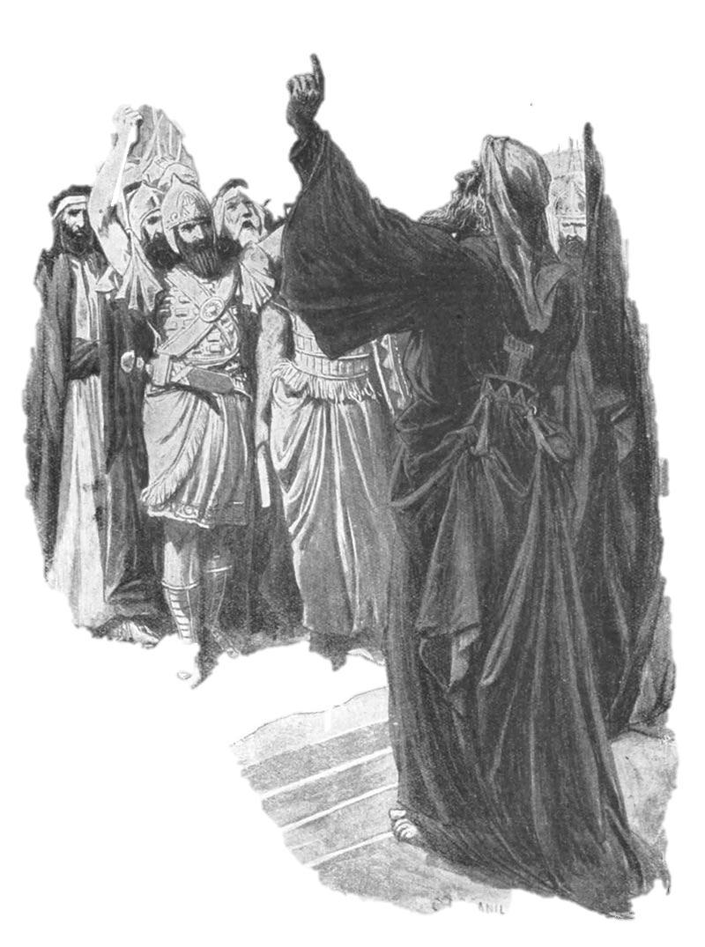
“And the LORD said unto Samuel, Hearken unto the voice of the people in all that they say unto thee: for they have not rejected thee, but the have rejected me, that I should not reign over them…Now therefore hearken unto their voice: howbeit yet protest solemnly unto them, and shew them the manner of the king that shall reign over them. (I Sam 8:7-9)”

Slide 37
Human Government
O Israel, thou hast destroyed thyself; but in me is thine help. I will be thy king: where is any other that may save thee in all thy cities? and thy judges of whom thou saidst, Give me a king and princes? I gave thee a king in mine anger, and took him away in my wrath. (Hos 13:9-11)

Slide 38
Human Government
This matter is by the decree of the watchers, and the demand by the word of the holy ones: to the intent that the living may know that the most High ruleth in the kingdom of men, and giveth it to whomsoever he will, and setteth up over it the basest of men. (Dan 4:17)

Slide 39
Peter Riedemann
“From these words we can se how the authority of the Government grew and where it came from, namely, from the wrath of God. We read in scripture, ‘ You said, ‘give us a king.’ So in my anger I gave you a king and in my wrath I took him away. “ These words show us that governmental authority was not given from grace but from disfavor and anger.” (pg 131-132)

Slide 40
Ministry of the sword
(Before the flood) “God no longer wanted His spirit to strive with those who were carnally minded, and yet He did not want the earth to be completely bloodstained or the evildoers to remain unpunished. Therefore, he had to have an instrument of punishment. That as it was said above was the ruling power to which He gave the command that whosoever sheds human blood, shall also have his blood shed. Form this we see that power and government have grown from God’s wrath and punishment, rather than from His blessing. “
“…Since people did not want to let themselves by the spirit of the Lord, God had to use a different rod to protect them from harm. This was done so that the land would not be completely polluted with bloodguilty people, and so that He would not have to destroy the whole world on their account. The world could thus be preserved until the time of the promised offspring, in whom all things would be made right.” Pg. 215-222

Slide 41
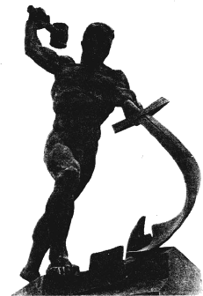
The prophets told of a time when this would be restored.
And it shall come to pass in the last days, that the mountain of the LORD'S house shall be established in the top of the mountains, and shall be exalted above the hills; and all nations shall flow unto it. And many people shall go and say, Come ye, and let us go up to the mountain of the LORD, to the house of the God of Jacob; and he will teach us of his ways, and we will walk in his paths: for out of Zion shall go forth the law, and the word of the LORD from Jerusalem. And he shall judge among the nations, and shall rebuke many people: and they shall beat their swords into plowshares, and their spears into pruninghooks: nation shall not lift up sword against nation, neither shall they learn war any more. (Is 2:2-4)

Slide 42
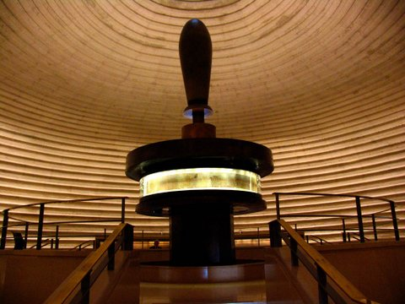

Slide 43
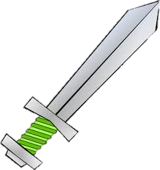
“Every battle of the warrior…”
“The people that walked in darkness have seen a great light: they that dwell in the land of the shadow of death, upon them hath the light shined. Thou hast multiplied the nation, and not increased the joy: they joy before thee according to the joy in harvest, and as men rejoice when they divide the spoil. For thou hast broken the yoke of his burden, and the staff of his shoulder, the rod of his oppressor, as in the day of Midian. For every battle of the warrior is with confused noise, and garments rolled in blood; but this shall be with burning and fuel of fire.”

Slide 44
A child is born!
For unto us a child is born, unto us a son is given: and the government shall be upon his shoulder: and his name shall be called Wonderful, Counsellor, The mighty God, The everlasting Father, The Prince of Peace. Of the increase of his government and peace there shall be no end, upon the throne of David, and upon his kingdom, to order it, and to establish it with judgment and with justice from henceforth even for ever. The zeal of the LORD of hosts will perform this. (Is 9:2-7)

Slide 45
It’s not about you…
“And when they entered unto the heathen, whither they went, they profaned my holy name, when they said to them, These are the people of the LORD, and are gone forth out of his land. But I had pity for mine holy name, which the house of Israel had profaned among the heathen, whither they went. Therefore say unto the house of Israel, Thus saith the Lord GOD; I do not this for your sakes, O house of Israel, but for mine holy name's sake, which ye have profaned among the heathen, whither ye went.

Slide 46
God desires to bless the world through His people.
And I will sanctify my great name, which was profaned among the heathen, which ye have profaned in the midst of them; and the heathen shall know that I am the LORD, saith the Lord GOD, when I shall be sanctified in you before their eyes. For I will take you from among the heathen, and gather you out of all countries, and will bring you into your own land.
Then will I sprinkle clean water upon you, and ye shall be clean: from all your filthiness, and from all your idols, will I cleanse you. A new heart also will I give you, and a new spirit will I put within you: and I will take away the stony heart out of your flesh, and I will give you an heart of flesh. And I will put my spirit within you, and cause you to walk in my statutes, and ye shall keep my judgments, and do them. “ (EZ 36:20-27)
“ ….and in thee shall all families of the earth be blessed. (Gen 12:3)

Slide 47
Homework
Read Matthew the Sermon on the Mount Matthew 5-7. Create a church that does exactly the opposite.

